Slide 1
Learning Objective
I will be able to apply knowledge of first and second derivatives
Success Criteria
At the end of the lesson, I will be able to:
Apply knowledge of first and second derivatives to identify and organise relevant information from parts of a problem to solve subsequent problems.

Slide 2




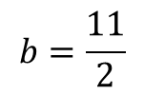
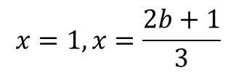
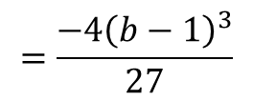

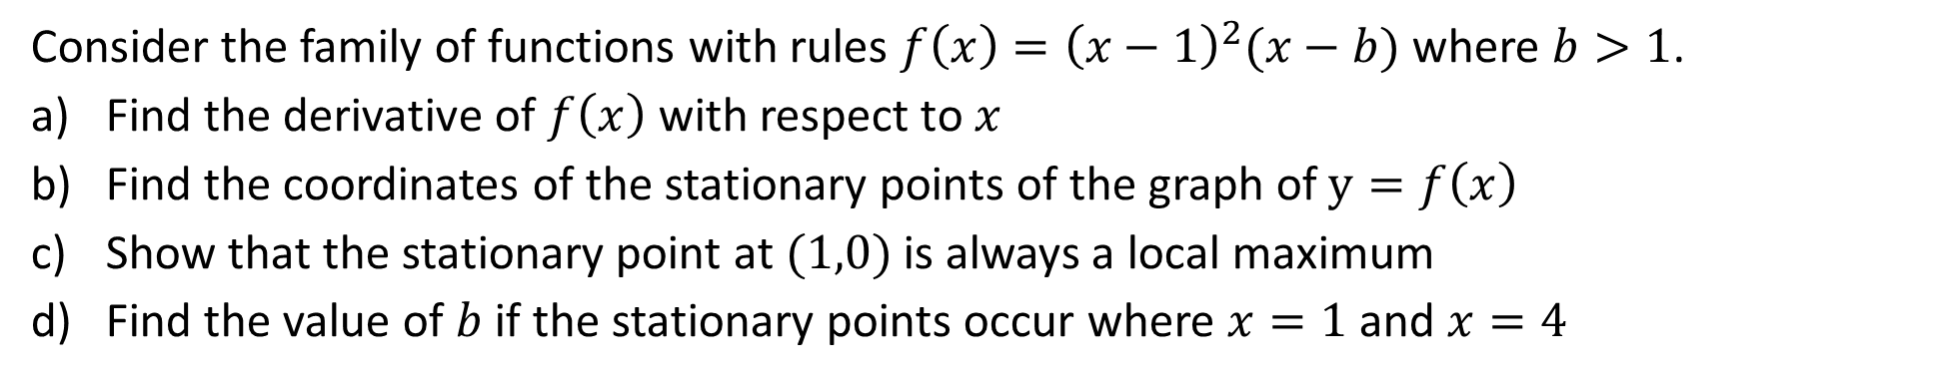



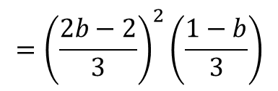


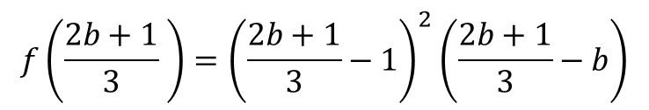
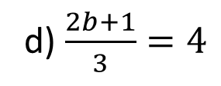

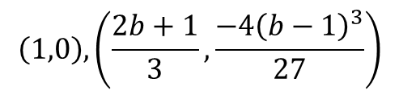

Guided Practice
Consider the family of functions with rules $f\left(x\right)={\left(x−1\right)}^{2}(x−b)$ where $b>1$.
Find the derivative of $f\left(x\right)$ with respect to $x$
Find the coordinates of the stationary points of the graph of $y=f\left(x\right)$
Show that the stationary point at $(1,0)$ is always a local maximum
Find the value of $b$ if the stationary points occur where $x=1$ and $x=4$
a) $f^{′}\left(x\right)=2\left(x−1\right)\left(x−b\right)+{\left(x−1\right)}^{2}$
c) $f^{′′}\left(x\right)=\left(3x−1−2b\right)+3(x−1)$
$$=\left(x−1\right)(2x−2b+x−1)$$
$$f^{′′}\left(1\right)=\left(3(1)−1−2b\right)$$
$$=\left(x−1\right)(3x−1−2b)$$
$$=2−2b=2(1−b)$$
b) Sub $f^{′}\left(x\right)=0,\left(x−1\right)\left(3x−1−2b\right)=0$
$$b>1∴1−b<0$$
$$x=1, x=\frac{2b+1}{3}$$
$$f^{′′}\left(1\right)=2\left(1−b\right)<0$$
$∴(1,0)$ is a local maximum point
$$f\left(1\right)=0$$
d) $\frac{2b+1}{3}=4$
$$f\left(\frac{2b+1}{3} \right)={\left(\frac{2b+1}{3}−1\right)}^{2}\left(\frac{2b+1}{3}−b\right)$$
$$2b+1=12$$
$$={\left(\frac{2b−2}{3}\right)}^{2}\left(\frac{1−b}{3}\right)$$
$$=\frac{−4{\left(b−1\right)}^{3}}{27}$$
$$\left(1,0\right), \left(\frac{2b+1}{3},\frac{−4{\left(b−1\right)}^{3}}{27}\right)$$
$$b=\frac{11}{2}$$

Slide 3







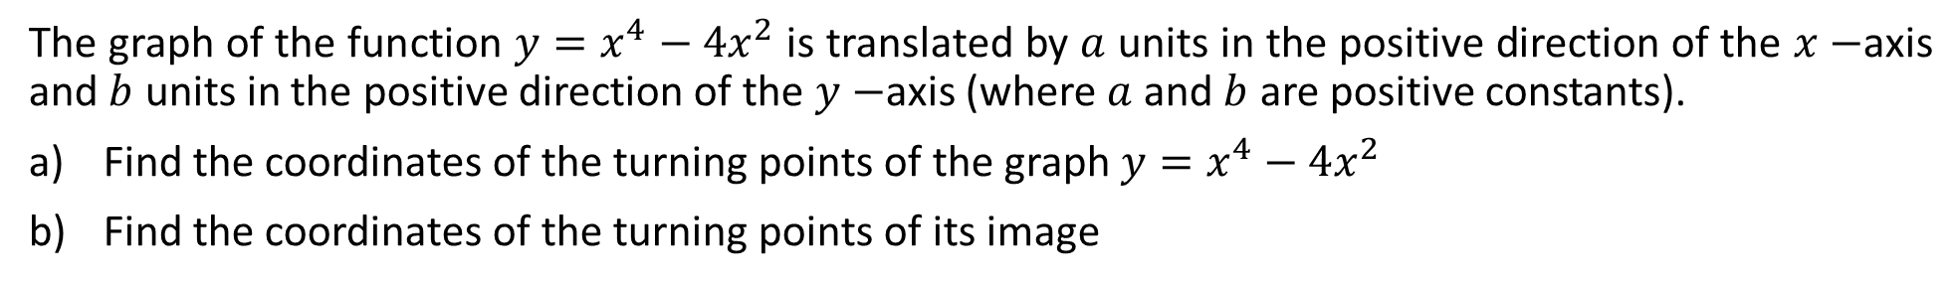







Guided Practice
The graph of the function $y=x^{4}−4x^{2}$ is translated by $a$ units in the positive direction of the $x−$axis and $b$ units in the positive direction of the $y−$axis (where $a$ and $b$ are positive constants).
Find the coordinates of the turning points of the graph $y=x^{4}−4x^{2}$
Find the coordinates of the turning points of its image
a) $\frac{dy}{dx}=4x^{3}−8x$
b) Translates $a$ units in the positive direction of the $x−axis$
Sub. $\frac{dy}{dx}=0, x\left(4x^{2}−8\right)=0$
→ $+a$ to the $x−coordinate$
Translates $b$ units in the positive direction of the $y−axis$
$$x=0, 4x^{2}−8=0$$
→ $+b$ to the $y−coordinate$
$$x^{2}=2$$
$$\left(a,b\right), \left(\sqrt{2}+a,−4+b\right), \left(−\sqrt{2}+a,−4+b\right)$$
$$x=±\sqrt{2}$$
Sub. $x=0, into y, y=0$
Sub. $x=\sqrt{2} into y, y={\left(\sqrt{2}\right)}^{4}−4{\left(\sqrt{2}\right)}^{2}$
$$y=4−8=−4$$
Sub. $x=−\sqrt{2} into y, y={\left(−\sqrt{2}\right)}^{4}−4{\left(−\sqrt{2}\right)}^{2}$
$$y=4−8=−4$$
$$\left(0,0\right), \left(\sqrt{2},−4\right) , \left(−\sqrt{2},−4\right)$$

Slide 4


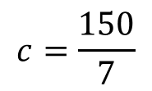




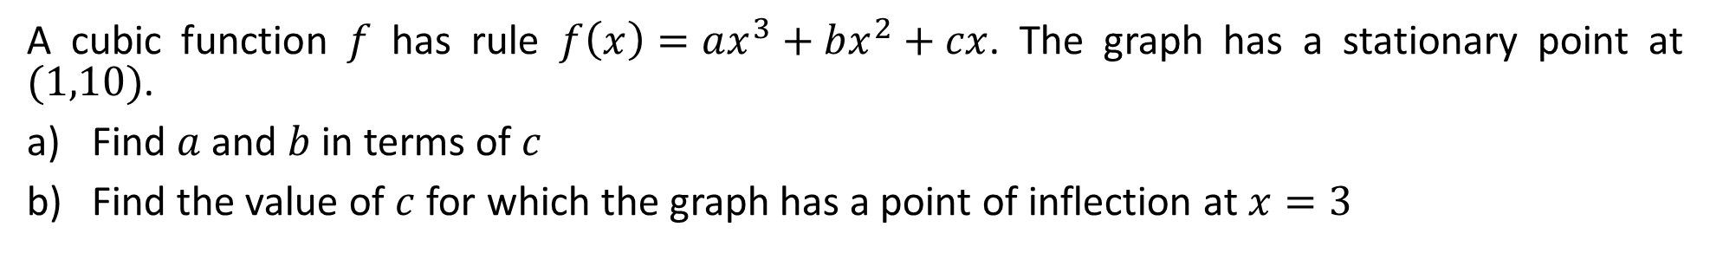









Guided Practice
A cubic function $f$ has rule $f\left(x\right)=ax^{3}+bx^{2}+cx$. The graph has a stationary point at $(1,10)$.
Find $a$ and $b$ in terms of $c$
Find the value of $c$ for which the graph has a point of inflection at $x=3$
a) Sub $f\left(1\right)=10, a+b+c=10$
b) $f^{′′}\left(x\right)=6ax^{ }+2b$
$a+b=10−c$ –(1)
Sub $f^{′′}\left(3\right)=0,$since at $x=3,$ there is a POI
$$f^{′}\left(x\right)=3ax^{2}+2bx+c$$
$$f^{′′}\left(3\right)=6a\left(3\right)+2b=0$$
Sub $f^{′}\left(1\right)=0, 3a+2b+c=0$
$$18(c−20)+2(30−2c)=0$$
$$18c−360+60−4c=0$$
$3a+2b=−c$ –(2)
$$14c=300$$
(2)- 2(1),
$$c=\frac{150}{7}$$
$3a+2b−2\left(a+b\right)=−c−2(10−c)$)
$$a=c−20$$
From (1), $c−20+b=10−c$
$$b=30−2c$$

Slide 5
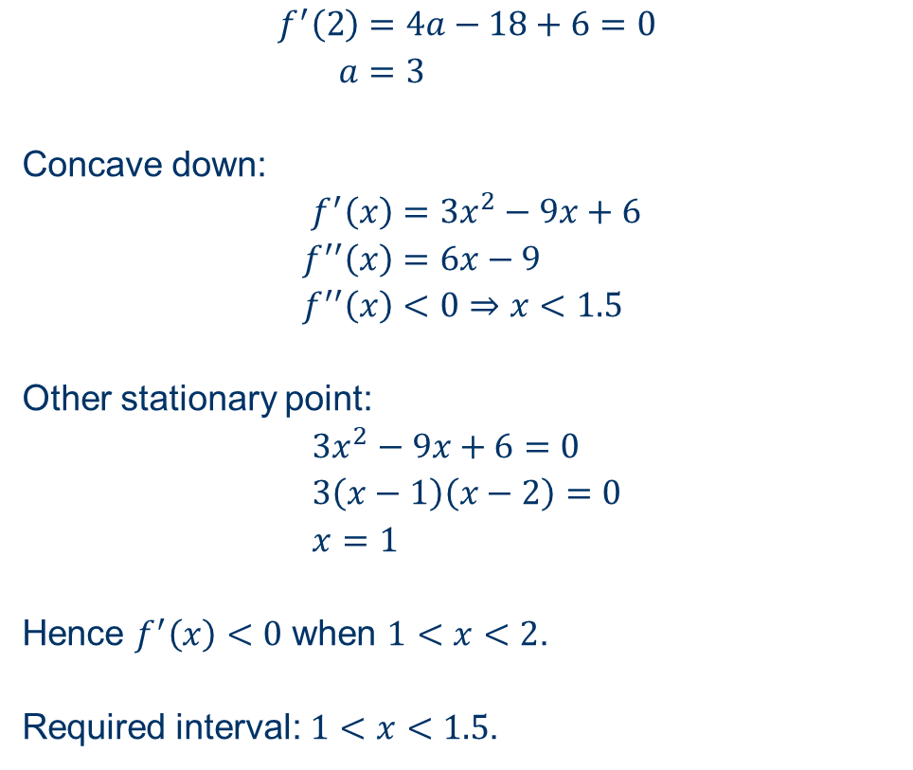
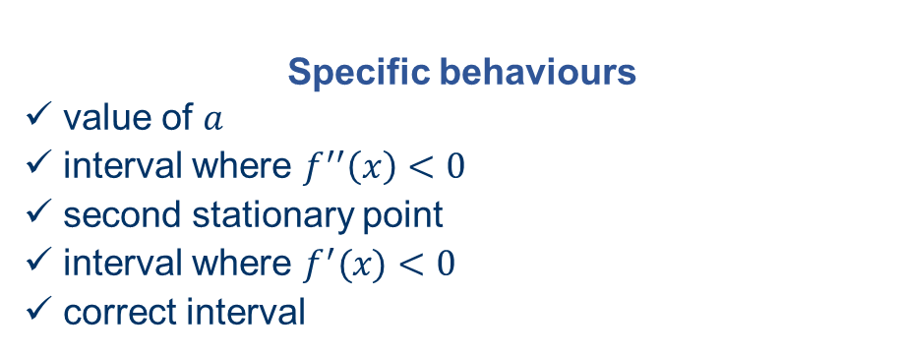
WACE Calc-Free (2020 – 5 marks)
The graph of $y=f(x)$ has a stationary point at $(2, 5)$ and $f^{′}\left(x\right)=ax^{2}−9x+6$, where $a$ is a constant.
Determine the interval over which $f^{′}\left(x\right)<0$ and $f^{′′}\left(x\right)<0$.
$$f^{′}\left(2\right)=4a−18+6=0 \\ a=3$$
Concave down:
$$f^{′}\left(x\right)=3x^{2}−9x+6 \\ f^{′′}\left(x\right)=6x−9 \\ f^{′′}\left(x\right)<0⇒x<1.5$$
Other stationary point:
$$3x^{2}−9x+6=0 \\ 3\left(x−1\right)\left(x−2\right)=0 \\ x=1$$
Hence $f^{′}\left(x\right)<0$ when $1<x<2$.
Required interval: $1<x<1.5$.
Specific behaviours
✓ value of $a$
ü interval where $f^{′′}\left(x\right)<0$
ü second stationary point
ü interval where $f^{′}(x)<0$
ü correct interval

Slide 6
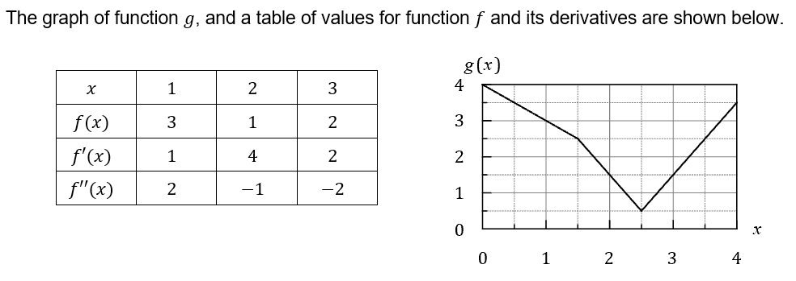
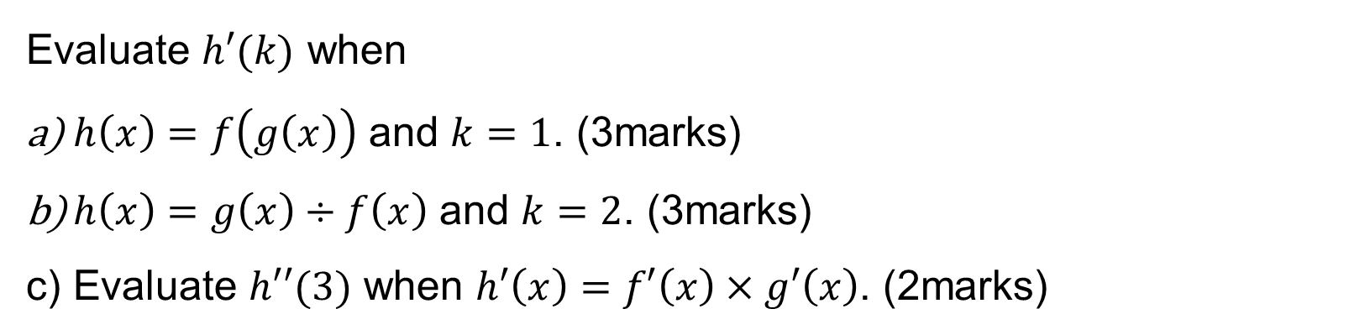
WACE Calc-Assumed (2021 – 8 marks)
Evaluate $h′(k)$ when
$h\left(x\right)=f\left(g\left(x\right)\right)$ and $k=1$. (3marks)
$h\left(x\right)=g\left(x\right)÷f\left(x\right)$ and $k=2$. (3marks)
Evaluate $h′′(3)$ when $h′\left(x\right)=f′\left(x\right)×g′\left(x\right)$. (2marks)

Slide 7
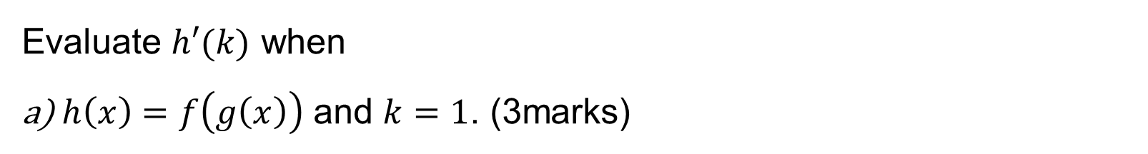
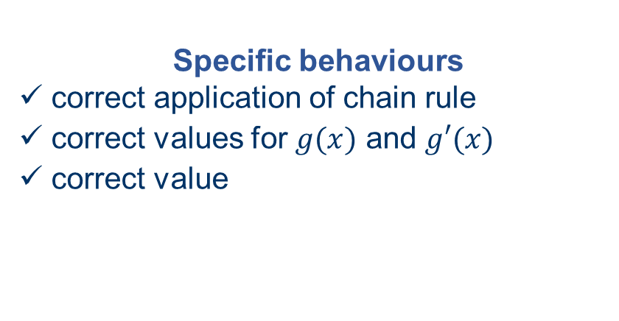
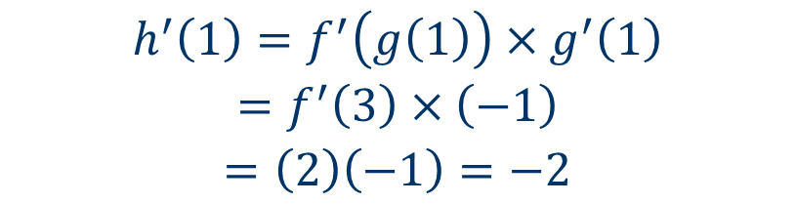
WACE Calc-Assumed (2021 – 8 marks)
Evaluate $h′(k)$ when
$h\left(x\right)=f\left(g\left(x\right)\right)$ and $k=1$. (3marks)
Specific behaviours
✓ correct application of chain rule
ü correct values for $g(x)$ and $g′(x)$
ü correct value
$$h^{′}\left(1\right)=f^{′}\left(g\left(1\right)\right)×g^{′}\left(1\right)$$
$$=f^{′}\left(3\right)×\left(−1\right)$$
$$=\left(2\right)\left(−1\right)=−2$$

Slide 8
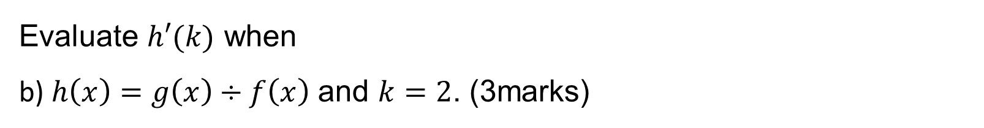
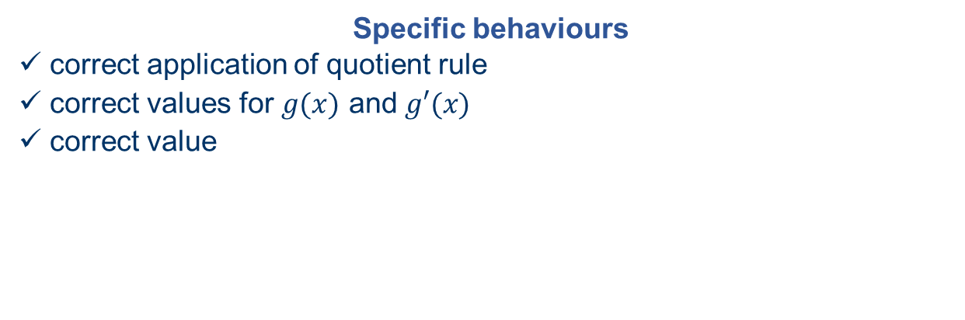
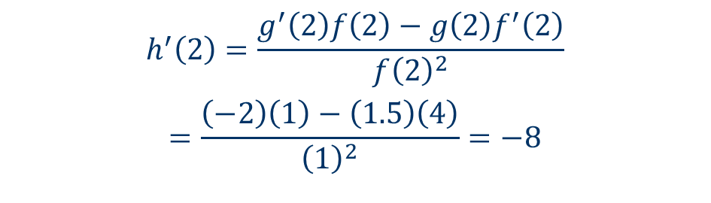
WACE Calc-Assumed (2021 – 8 marks)
Evaluate $h′(k)$ when
b) $h\left(x\right)=g\left(x\right)÷f\left(x\right)$ and $k=2$. (3marks)
$$h^{′}\left(2\right)=\frac{g^{′}\left(2\right)f\left(2\right)−g\left(2\right)f^{′}\left(2\right)}{f{\left(2\right)}^{2}}$$
$$=\frac{\left(−2\right)\left(1\right)−\left(1.5\right)\left(4\right)}{{\left(1\right)}^{2}}=−8$$
Specific behaviours
✓ correct application of quotient rule
ü correct values for $g(x)$ and $g′(x)$
ü correct value

Slide 9
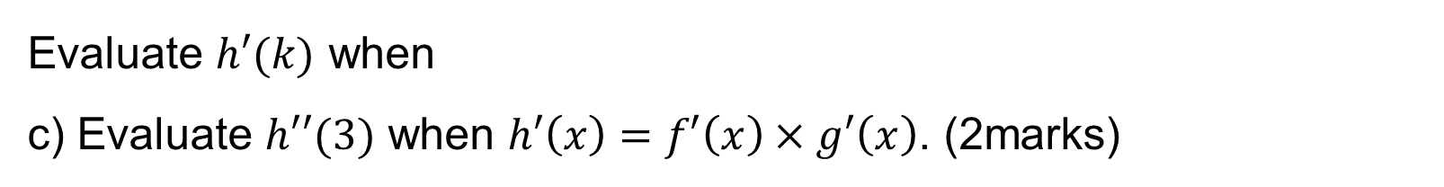
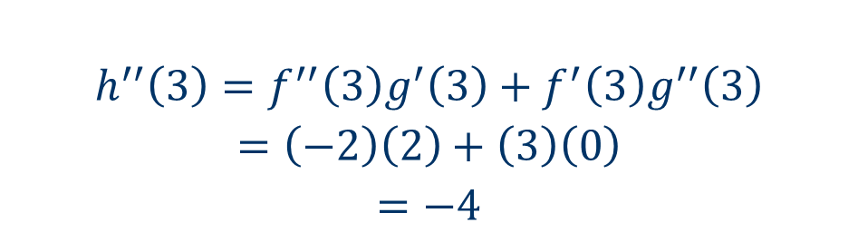
WACE Calc-Assumed (2021 – 8 marks)
Evaluate $h′(k)$ when
c) Evaluate $h′′(3)$ when $h′\left(x\right)=f′\left(x\right)×g′\left(x\right)$. (2marks)
$$h^{′′}\left(3\right)=f^{′′}\left(3\right)g^{′}\left(3\right)+f^{′}\left(3\right)g^{′′}\left(3\right)$$
$$=\left(−2\right)\left(2\right)+\left(3\right)\left(0\right)$$
$$=−4$$
Specific behaviours
✓ uses product rule with at least two correct values
ü correct result

Slide 10
Independent Practice
Complete Cambridge Ex 5I

